Slide 1

Minders’ 25 FrontEnd
Committee
Session Seven

Slide 2




Table of contents
01
02
03
Recap
BOM
Events

Slide 3
01
Point 1 Recap

Slide 4
Come to the stage
يا حلو (☆▽☆)

Slide 5
02
Point
BOM

Slide 6
BOM
Properties
1- window.innerWidth
2- window.innerHeight
3-window.location
4-window.localStorage
5-window.sessionStorage
6-window.document

Slide 7
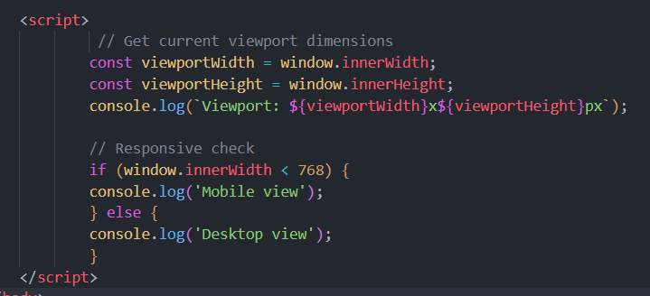

BOM
Properties
1- window.innerWidth/ window.innerHeight Viewport dimensions (what users see)

Slide 8
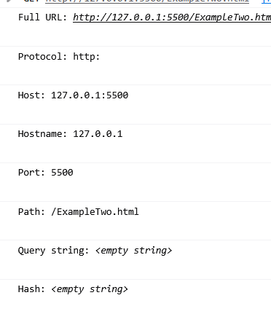
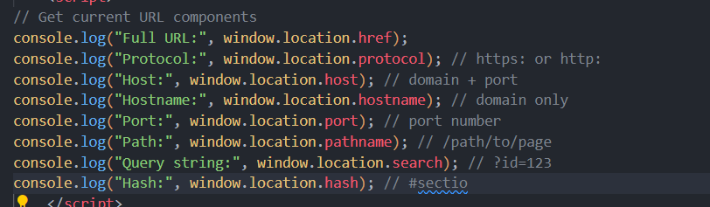
BOM
Properties
3- window.location Access and manipulate the current URL

Slide 9
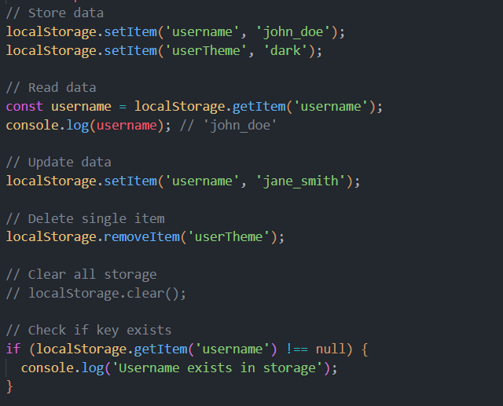
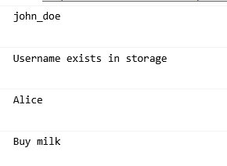
BOM
Properties
4-window.localStorage Client-side storage

Slide 10
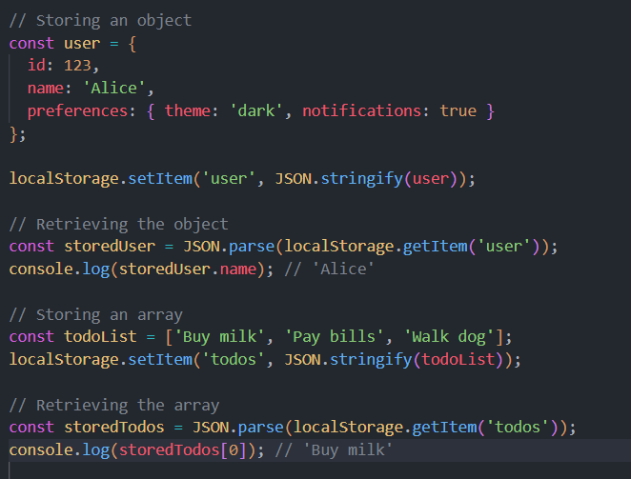
BOM
Properties
4-window.localStorage Client-side storage

Slide 11
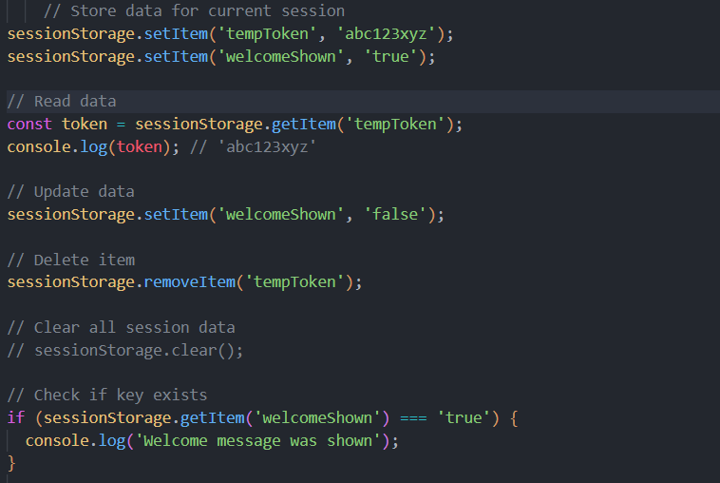

BOM
Properties
5-window.sessionStorage
session-based persistence (data clears when the browser tab closes)

Slide 12
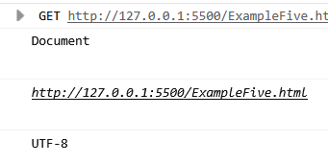
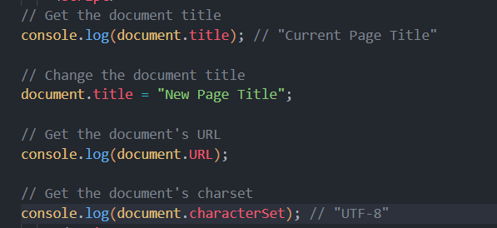
BOM
Properties
6-window.document
is the entry point to the DOM (Document Object Model).

Slide 13
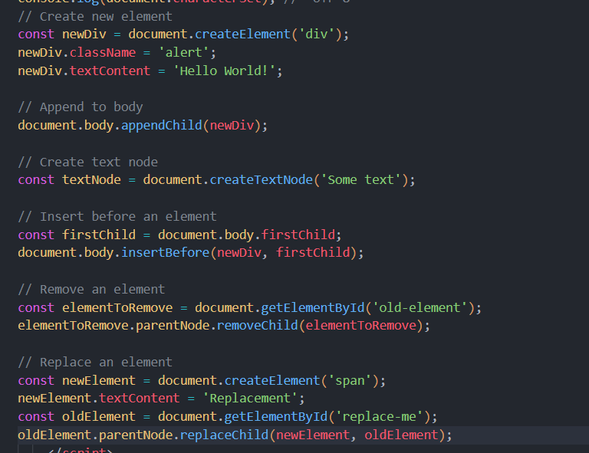

BOM
Properties
6-window.document
is the entry point to the DOM (Document Object Model).

Slide 14
BOM
Methods
1-window.alert()
2- window.confirm()
3-window.prompt()
4-window.setTimeout()
5-window.setInterval()

Slide 15
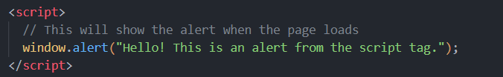
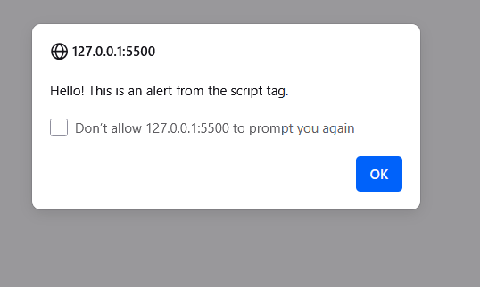
BOM
Methods
1-window.alert()

Slide 16
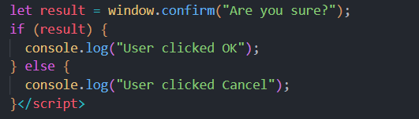
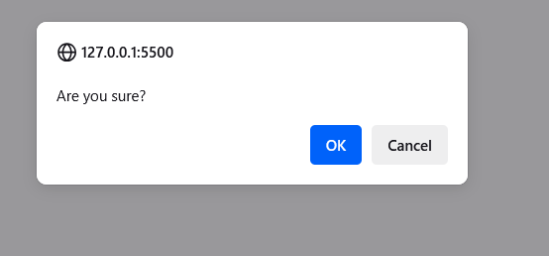
BOM
Methods
2-window.confirm()

Slide 17
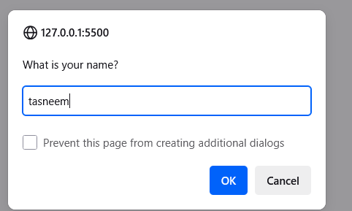
BOM
Methods
3-window.prompt()

Slide 18
BOM
Methods
3-window.prompt()

Slide 19

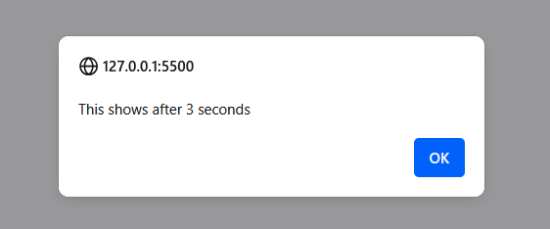
BOM
Methods
4-window.setTimeout()

Slide 20

BOM
Methods
5-window.setInterval()

Slide 21
02
Point
events

Slide 22
Events
What are Events?
Events are actions that happen in the browser — like when a user clicks, types, hovers, loads a page, etc.
JavaScript can respond to these events using event listeners

Slide 23
Events
1-onclick()
2-onmouseover()
3-onload()
4-addEventListener()

Slide 24
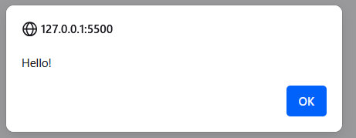

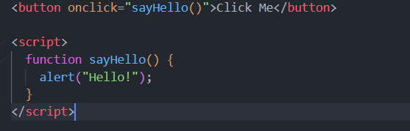
Events
1-onclick()
When an element is clicked

Slide 25
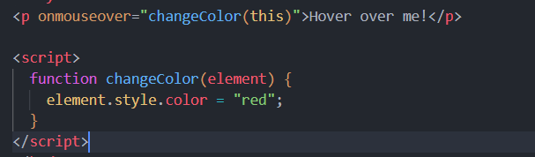


Events
2-onmouseover()
When mouse hovers over an element

Slide 26
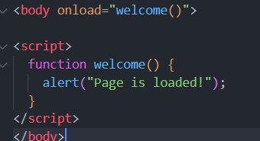
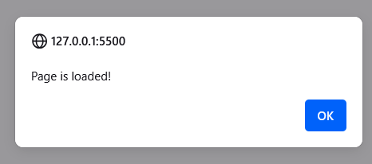
Events
3-onload()
When the page finishes loading

Slide 27
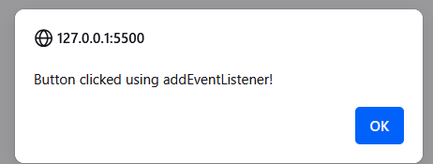
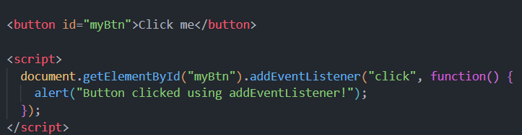

Events
4-addEventListener()
Modern way to handle events

Slide 28
Conclusion

Slide 29
Thanks for Your attention with us (☆▽☆)
Have Good weekends with the tasks o(≧∀≦)o

